Slide 1

Creational Design Patterns

Slide 2
Table of contents
1
2
3
System Design
Design Patterns
Summary

Slide 3
System Design
System Design
Low Level Design
High Level Design
Object Oriented Principles (OOP)
Solid Principles
Web Sockets
Polling
Analyzing and designing
Design Patterns
UML Diagram
Filtering
Rate limiting

Slide 4
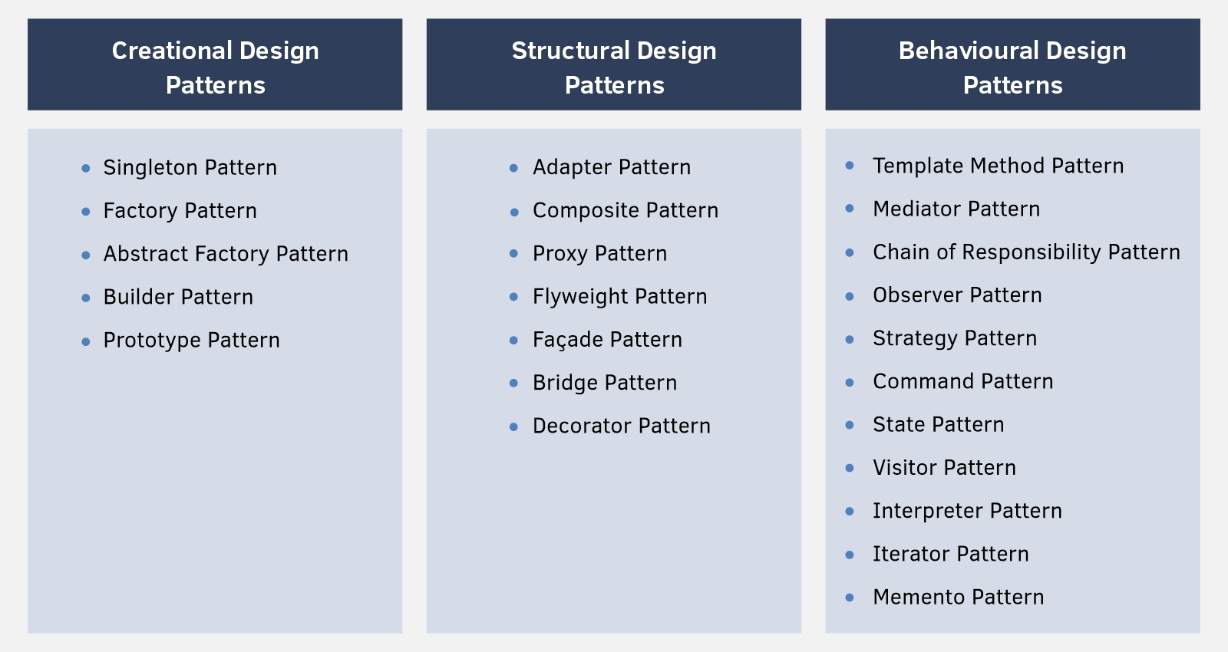
Design Patterns
1
2
3
4
5
Builder Design Pattern
Prototype Design Pattern
Singleton Design Pattern
Abstract Design Pattern
Abstract Factory Pattern

Slide 5
Creational Design Pattern
A creational design pattern is a design pattern that deals with object creation mechanisms, attempting to create objects in a manner suitable for the situation. Creational design patterns aim to provide flexibility in object creation while promoting code reuse and minimizing dependencies between the code that creates objects and the code that uses them.

Slide 6
Builder Design Pattern
The Builder design pattern is a creational design pattern that is used to construct complex objects step by step. It separates the construction of an object from its representation, allowing the same construction process to create different representations.
It is used to construct a complex object step by step and the final step will return the object.
The main goal of the Builder pattern is to provide a flexible solution for creating objects with different configurations or optional parameters without having to define multiple constructors or overwhelming constructor parameters. It promotes a fluent and readable syntax for constructing objects, making the code more maintainable and easier to understand.

Slide 7
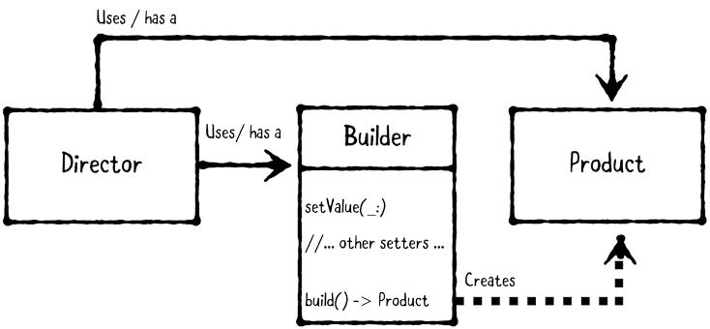
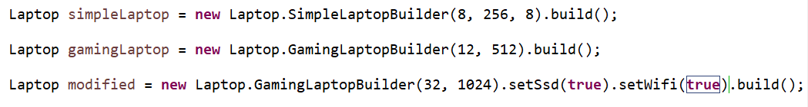
Implementing Builder Design Pattern
Define the product: First, you define the object you want to construct. It can be a complex object with many attributes or configuration options.
Create an abstract builder: Next, create an abstract builder class that defines the common construction steps for building the object. This builder class should have methods for setting the different attributes or configurations of the object.
Create concrete builders: Implement concrete builder classes that inherit from the abstract builder. Each concrete builder provides its own implementation for the construction steps defined in the abstract builder.
Create a director (optional): You can create a director class that controls the construction process.
Retrieve the product: Finally, the client code can retrieve the fully constructed object from the builder. The product is typically obtained through a method provided by the builder.

Slide 8
Advantages of Builder Design Pattern:
Flexible object construction: The Builder pattern allows you to construct objects step by step, providing flexibility in creating objects with different configurations. Builders can have methods to set optional parameters or handle complex initialization logic, making it easy to construct objects with various configurations.
Readable and fluent syntax: By using method chaining and a fluent interface, the Builder pattern provides a readable and expressive way to construct objects. The code becomes self-explanatory, making it easier to understand the construction process.

Slide 9
Prototype Design Pattern
The Prototype design pattern is a creational design pattern that allows you to create copies of existing objects without coupling your code to their specific classes. It provides a way to create new objects by copying existing instances, known as prototypes, rather than creating new objects from scratch. This pattern promotes flexibility and reduces the complexity of creating new objects by cloning existing ones.

Slide 10
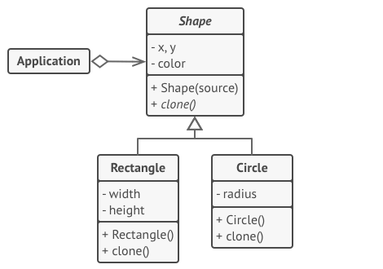
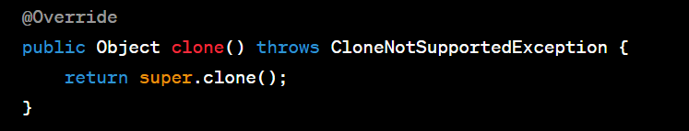
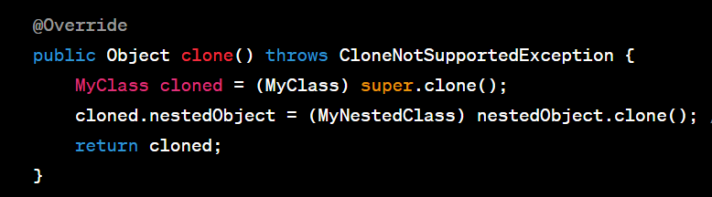
Implementing Prototype Design Pattern
Implement the cloneable marker interface
Shallow copy is a bit-wise copy of an object. A new object is created that has an exact copy of the values in the original object. If any of the fields of the object are references to other objects, just the reference addresses are copied i.e., only the memory address is copied.
A deep copy copies all fields, and makes copies of dynamically allocated memory pointed to by the fields. A deep copy occurs when an object is copied along with the objects to which it refers.

Slide 11
Advantages of Prototype Design Pattern:
Object creation flexibility: The Prototype pattern allows you to create new objects by cloning existing ones, rather than relying on subclassing or complex object creation logic. This provides flexibility in creating objects dynamically at runtime.
Improves performance: Creating objects from scratch can be a time-consuming and resource-intensive process. The Prototype pattern allows you to clone and modify existing objects, which can be more efficient than creating new instances. This is especially beneficial when object creation is a costly operation.

Slide 12
Singleton Design Pattern
The Singleton design pattern is a creational design pattern that ensures the existence of only one instance of a class in a program, but allowing the flexibility to create more objects if the situation changes, providing a global point of access to that instance.
Singleton pattern is used for logging, drivers objects, caching, and thread pool.
To implement a singleton pattern, we have different approaches, but all of them have the following common concepts:
Private constructor to restrict instantiation of the class from other classes.
Private static variable of the same class that is the only instance of the class.
Public static method that returns the instance of the class, this is the global access point for the outer world to get the instance of the singleton class.

Slide 13
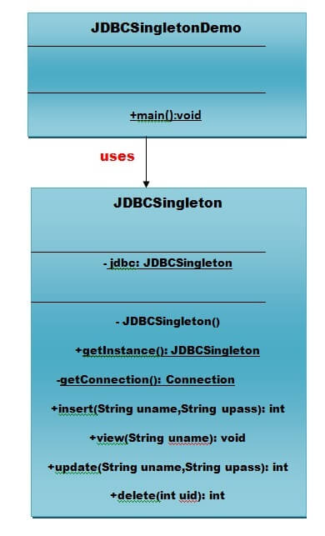
Implementing Singleton Design Pattern
You can create single pattern using three forms as listed below:
Eager Instantiation mean creation of instance at load time.
Static block Instantiation is similar to eager initialization except that instance of the class is created in the static block that provides the option for exception handling.
Lazy Instantiation mean creation of instance when required

Slide 14
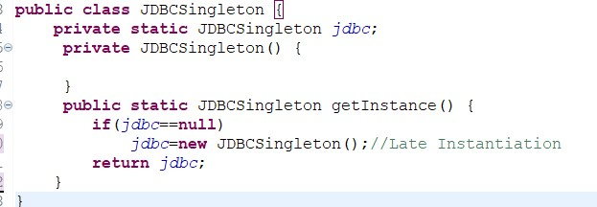
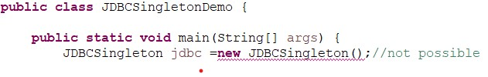
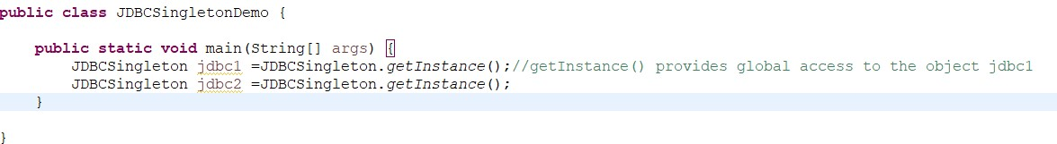
Implementing Singleton Design Pattern

Slide 15
Advantages of Singleton Design Pattern:
Global access: The Singleton instance can be accessed from anywhere in the code, making it convenient to use without the need to pass references between different components.
The Singleton pattern provides control over the object's creation and initialization process, ensuring that it is done in a consistent and controlled manner.
With proper implementation, the Singleton pattern can ensure thread safety by handling concurrent access and modification of shared resources.

Slide 16
Factory Design Pattern
The factory design pattern says that define an interface ( A java interface or an abstract class) for creating object and let the subclasses decide which class to instantiate.
The factory design pattern is used when we have a superclass with multiple sub-classes and based on input, we need to return one of the sub-class. This pattern takes out the responsibility of the instantiation of a class from the client program to the factory class.

Slide 17
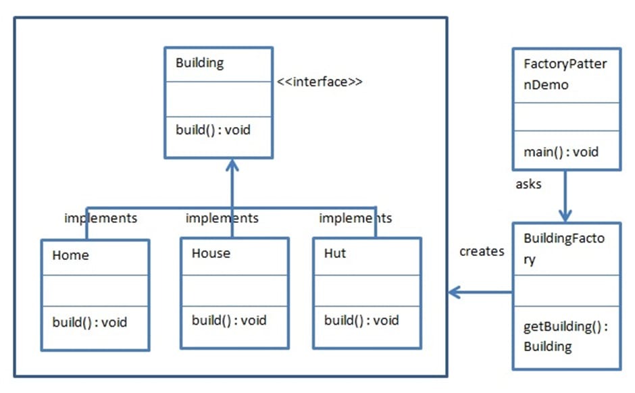
Implementing Factory Design Pattern

Slide 18
Advantages of Factory Design Pattern:
Factory pattern provides approach to code for interface rather than implementation.
Factory pattern removes the instantiation of actual implementation classes from client code, making it more robust, less coupled and easy to extend.
Factory pattern provides abstraction between implementation and client classes through inheritance.

Slide 19
Abstract Factory Design Pattern
An abstract factory pattern is also known called the Factory of Factories because it is a super factory that creates other factories. It provides an interface that is responsible for creating a factory of related objects without explicitly specifying their classes. The generated factory gives the objects related to the factory. It means the abstract factory pattern is an extended version of the factory pattern that adds one more layer..
Usage of Abstract Factory Pattern :
When the system needs to be independent of how its object are created, composed, and represented.
When the family of related objects has to be used together, then this constraint needs to be enforced.
When you want to provide a library of objects that does not show implementations and only reveals interfaces.

Slide 20
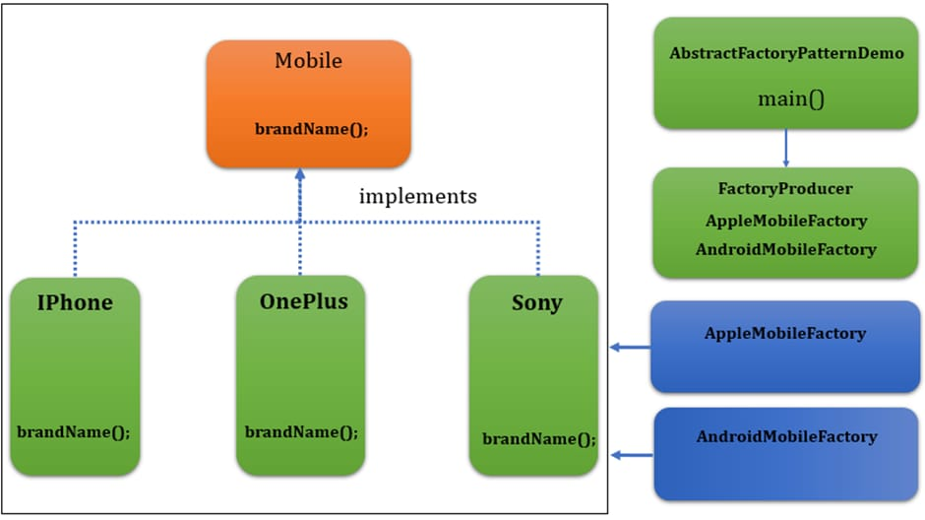
Implementing Abstract Factory Design Pattern

Slide 21
Advantages of Abstract Factory pattern Design Pattern:
The Abstract Factory pattern provides the control to create an object of classes. Also, It takes responsibility and the process of creating product objects. Clients manipulate instances through their abstract interfaces. So, The concrete class’s name is isolated in the implementation of the concrete factory.
The concrete factory or generated factory uses once in an application to instantiate itself. That provides an ease to make any change in an application uses. Hence, It can use various product configurations simply by changing the concrete factory.
It provides flexibility because it is a “factory of factories” and can be easily extended according to requirements. We can add more concrete and factories later.

Slide 22
Summary
Encapsulation of object creation: Creational patterns encapsulate the object creation process, hiding the complexities and details from the client code. This promotes a clean and intuitive interface for creating objects, making the code more readable and maintainable.
Improved code organization: By separating object creation from the rest of the code, creational patterns help organize and structure the codebase. This separation of concerns enhances code modularity and facilitates easier maintenance and updates.
Flexibility and extensibility: Creational patterns enable flexibility in object creation by allowing variations, configurations, and substitutions of objects. They provide a standardized approach to create objects, making it easier to introduce new object types or modify existing ones without affecting the rest of the code
Improved performance and resource utilization: Some creational patterns, such as Singleton and Flyweight, optimize object creation and reuse to improve performance and reduce memory usage. They ensure that only necessary objects are created, minimizing overhead and improving overall system efficiency.
Adherence to design principles: Creational patterns align with important software design principles such as encapsulation, separation of concerns, and dependency inversion. By following these principles, creational patterns contribute to building more robust, maintainable, and scalable software systems.

Slide 23

Thanks!
Do you have any questions?

